Slide 1
Computer Communication & Networks
Network Layer: IP and Address Mapping (contd.)
GitHub - AhmadNawaz110/CE313-Computer-Commincation-and-Network-Spring-2026-
Engr. M Ahmad Nawaz
Engr.ahmad.nawaz@giki.edu.pk

Slide 2
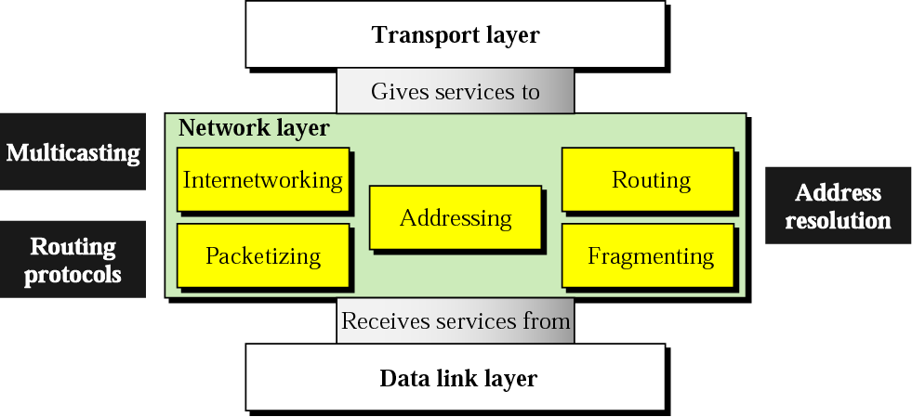
Network Layer

Slide 3
Network Layer
Concerned with getting packets from source to destination.
The network layer must know the topology of the subnet and choose appropriate paths through it.
When source and destination are in different networks, the network layer (IP) must deal with these differences.
Key issue: what service does the network layer provide to the transport layer (connection-oriented or connectionless).
Networks: Routing

Slide 4
Network Layer Design Goals
The services provided by the network layer should be independent of the subnet topology.
The Transport Layer should be shielded from the number, type and topology of the subnets present.
The network addresses available to the Transport Layer should use a uniform numbering plan (even across LANs and WANs).
Networks: Routing

Slide 5
Messages
Messages
Transport
layer
Segments
Transport
layer
Network
service
Network
service
Network
layer
Network
layer
Network
layer
Network
layer
End system
α
Data link
layer
Data link
layer
Data link
layer
Data link
layer
End system
β
Physical
layer
Physical
layer
Physical
layer
Physical
layer

Slide 6
Machine A
Machine B
Application
Application
Transport
Router/Gateway
Transport
Internet
Internet
Internet
Network Interface
Network Interface
Network Interface
Network 1
Network 2
Networks: Routing
Figure 8.3

Slide 7
Address Mapping

Slide 8
Address Mapping
The delivery of a packet to a host or a router requires two levels of addressing: logical and physical. We need to be able to map a logical address to its corresponding physical address and vice versa. This can be done by using either static or dynamic mapping.

Slide 9
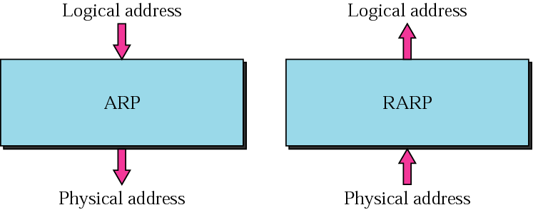
ARP and RARP

Slide 10
ARP - The Address Resolution Protocol
An IP datagram must be encapsulated in a frame to pass through the physical network. This requires the physical address of the receiver.
ARP associates an IP address with its physical address.
When the physical address of another host is required an ARP query packet is sent which includes
  IP address of sender
  IP address of the receiver
The intended recipient recognises its IP address and send back an ARP response which contains the physical address.

Slide 11

ARP operation

Slide 12

ARP Request & Reply

Slide 13

Proxy ARP

Slide 14
ARP functions
Sender knows IP address
IP asks ARP to create an ARP request message
  sender physical address
  sender IP address
  target IP address
  target physical address filled with 0's
Message passed to data link layer; destination address = broadcast address
All hosts receive frame; only target host accepts the packet
Target host replies (unicast) with an ARP reply message containing the physical address
Sender receives reply; it now knows the physical address of the target host
IP datagram's are now unicast to the destination host

Slide 15
Cache Table
A sender usually has more than one IP datagram to send to the same destination
It is inefficient to use ARP for each datagram
A cache table is used
  limited size
  mappings retained only for a limited time

Slide 16
RARP
Finds the logical address for a host that only knows its physical address
RARP request packets are broadcast; RARP reply packets are unicast
Used by diskless machines to obtain their IP addresses

Slide 17
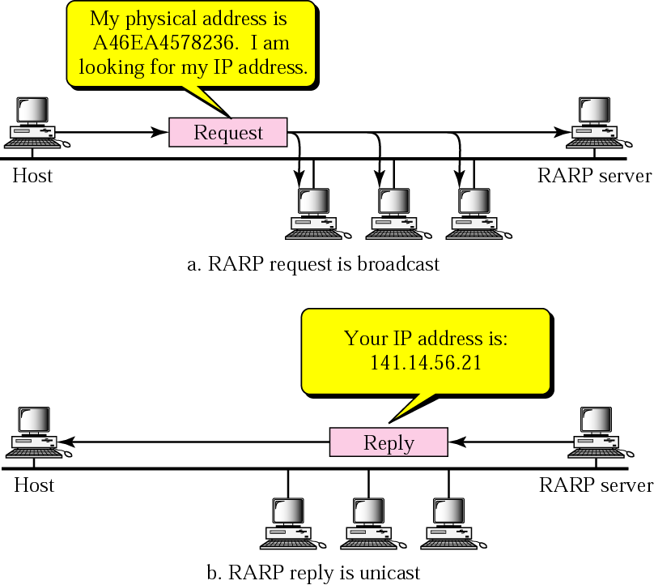
Operation

Slide 18

Note
An ARP request is broadcast;
an ARP reply is unicast.

Slide 19
ICMP

Slide 20
ICMP protocol
IP protocol is a best-effort delivery service, however it has two deficiencies
  Lack of error control
  Lack of assistance mechanisms
IP protocol has no error-reporting or error-correction mechanism
  What happens when something goes wrong?
  What happens if a router must discard a datagram because it cannot find a route to the final destination?
  What if the time-to-live field has a zero value?
  What if it has to discard all fragments because not all were received in a predetermined time limit?
IP protocol also lacks a mechanism for host and management queries.
ICMP was designed to compensate for these deficiencies.

Slide 21
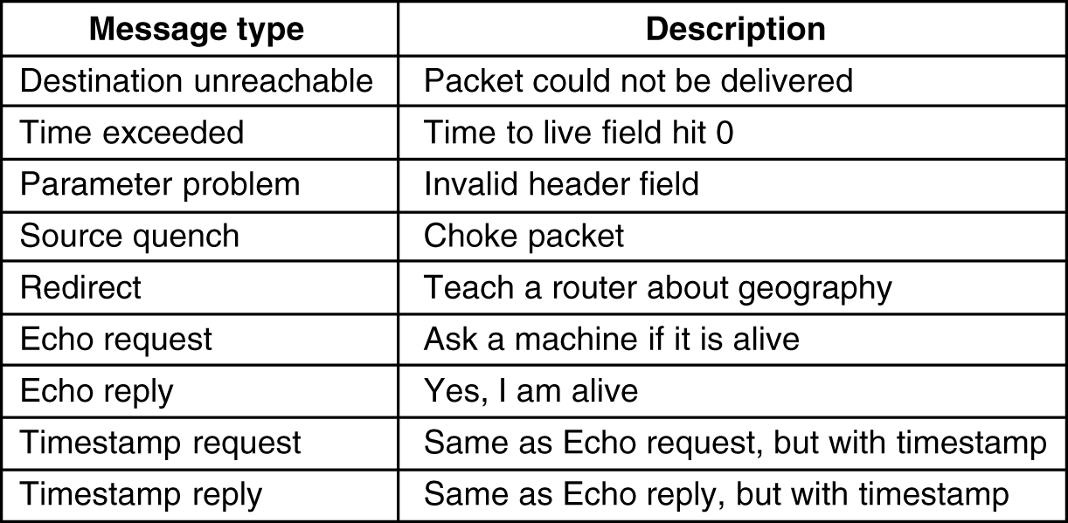
Internet Control Message Protocol (ICMP)
ICMP is used by routers for exchanging error information and for testing. The principal ICMP message types are shown below.

Slide 22
Internet Control Message Protocol (ICMP)
Encapsulated in IP packet
Handles error and control messages
If router cannot deliver or forward a packet, it sends an ICMP “host unreachable” message to the source
If router receives packet that should have been sent to another router, it sends an ICMP “redirect” message to the sender; Sender modifies its routing table
ICMP “router discovery” messages allow host to learn about routers in its network and to initialize and update its routing tables
ICMP echo request and reply facilitate diagnostic and used in “ping”

Slide 23
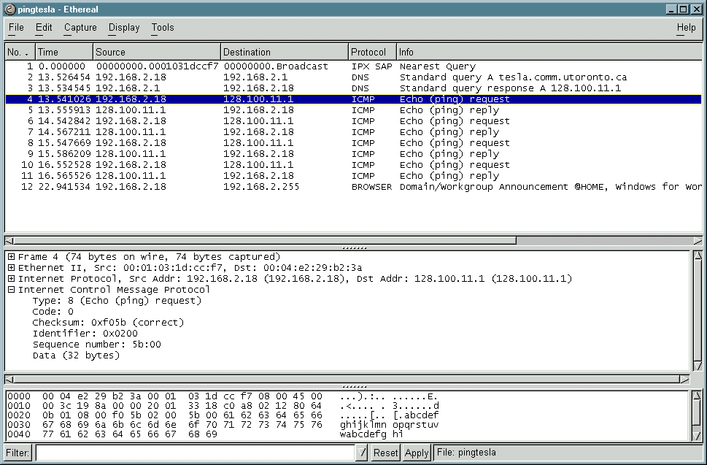
Example – Echo request

Slide 24
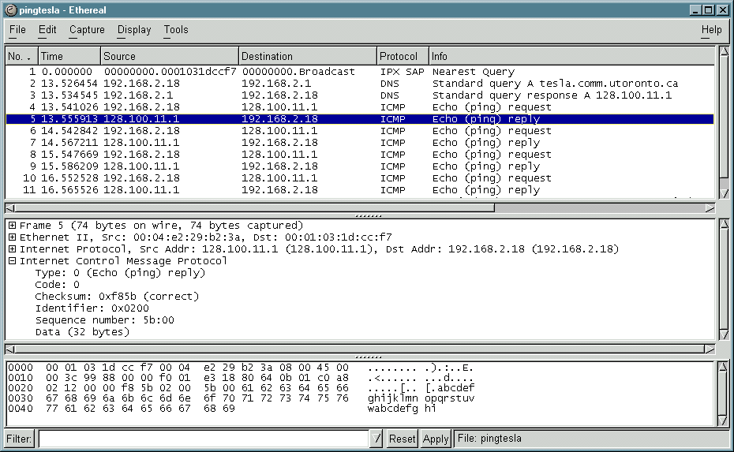
Example – Echo Reply

Slide 25

General format of ICMP messages

Slide 26
Note
ICMP always reports error messages to the original source.

Slide 27
Quiz 4
Assuming class full addressing, what is the default subnet mask for the IP address 126.0.0.0: [1]
Assuming classless IP addressing, what is the subnet mask for the IP address 126.0.0.0/23: [1]
Consider the IP address 200.10.10.10/25. What is the maximum number of interfaces (hosts) supported by the network, of which this IP address is a part? [1]
An organization is granted the block of IP addresses: 130.34.12.64/26. The organization needs to have four subnets of equal size, i.e. with equal number of hosts.
Provide the range of IP addresses (of the form a.b.c.d/x) for each subnet.
Explain your work! [8]

